Slide 1
PRODUCT DEVELPOMENT LABORATORY
Department of Computer Science and Engineering NIT ROURKELA
Title: Machine Reading Comprehension
END-SEM EVALUATION PRESENTATION

Slide 2
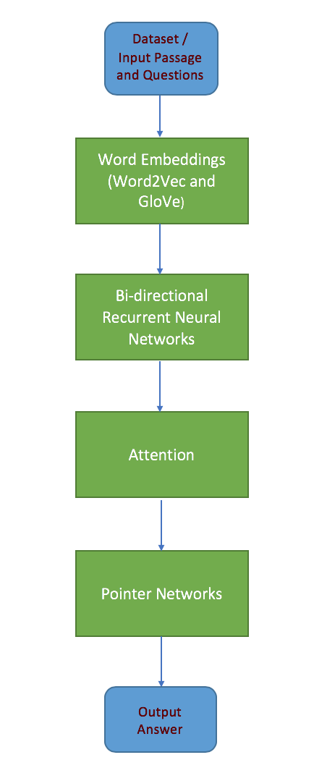
FLOWCHART OF THE WORKFLOW
The model utilizes
Word embeddings
Bidirectional Recurrent Neural Networks (Bi RNN)
Attention in neural networks to highlight
some part of the text under the context of the other.
Pointer Networks

Slide 3
Work till Mid-semester
Data Analysis of SQuAD
One Hot Encoding
Word Embeddings
GloVe
Cosine Similarity

Slide 4
Work done till Mid semester
Complete data analysis of SQuAD dataset was performed and various statistics were derived.
Few techniques for converting words to numerical values were presented.
One hot encoding: Naïve method
Various drawbacks of this method (high space complexity and less efficient)
Drawbacks were solved by the concept of word embeddings
Each word is represented by a vector in a fixed sized dimensional space
Each feature has a value in the range [-1,1]
GloVe is one of the algorithms to represent word embeddings
It achieves better results faster.

Slide 5
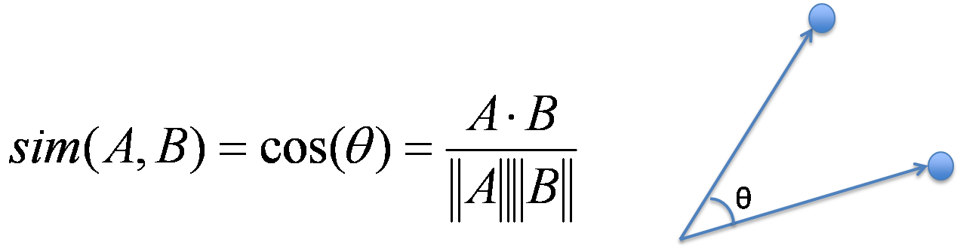
COSINE SIMILARITY
Cosine similarity is calculated based on the angle between the two vectors.
It measures the cosine of the angle between the two vectors projected in a multi-dimensional space.
Cosine Similarity values lie in the range [-1, 1].
It can be found using the formula

Slide 6
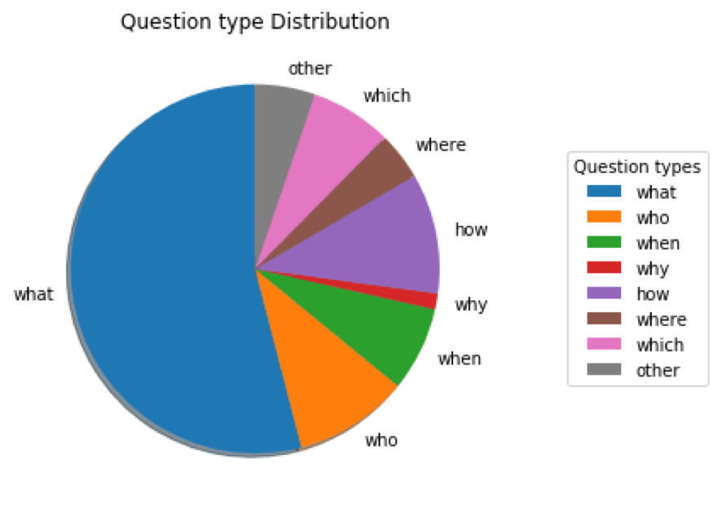
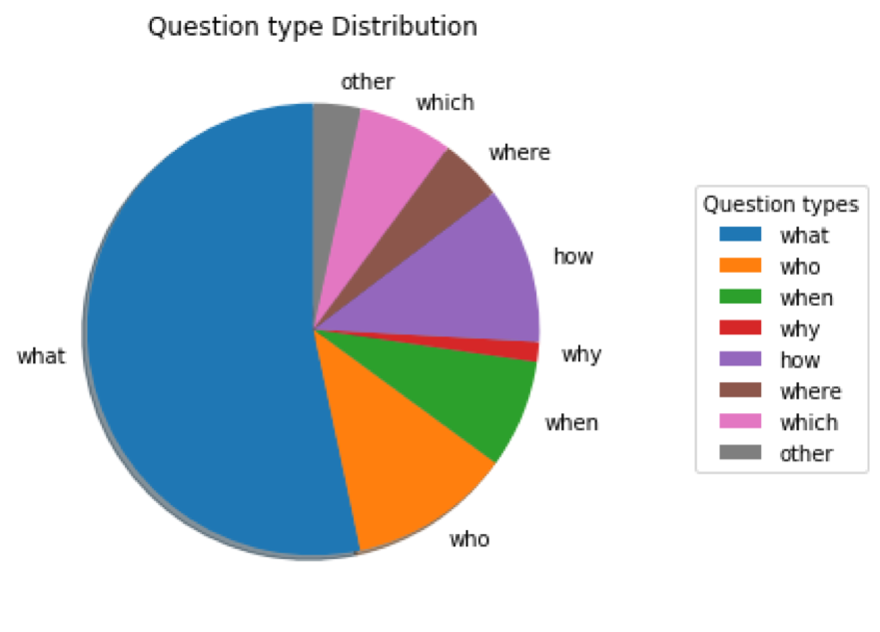
TRAIN SET Vs TEST SET
RESULTS (Till mid semester)
Distribution of question type
in train set
Distribution of question type
in test set

Slide 7
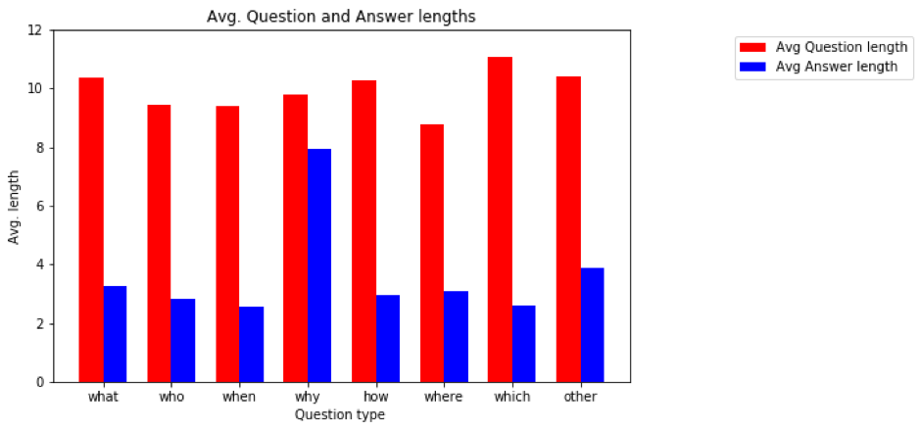
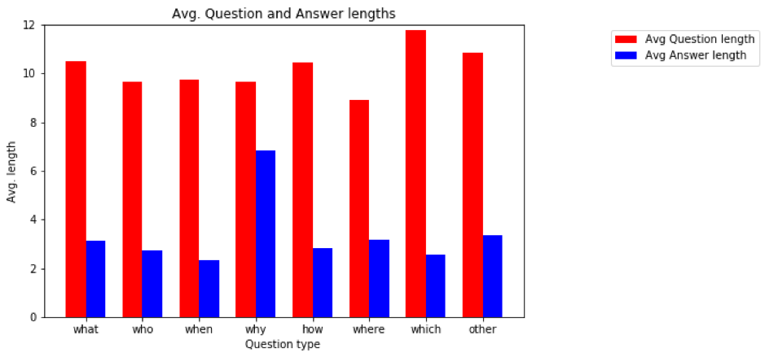
TRAIN SET Vs TEST SET
RESULTS (Till mid semester)
Average length of Questions and Answers
in training set
Average length of Questions and Answers in test set

Slide 8
STATISTICAL ANALYSIS OF THE DATASET
S no | Statistical aspect | Train set | Test set
1 | Title count | 442 | 48
2 | Total word count | 91,87,544 | 10,93,051
3 | Total Question count | 87,599 | 10,570
4 | Context count | 18,896 | 2,067
5 | Avg Question length | 10.46 | 10.82
6 | Avg Answer length | 3.26 | 3.15
7 | Avg Context length | 117 | 123
8 | Avg Question count per context | 4.64 | 5.11

Slide 9
Cosine Similarity as per context of paragraphs of dataset
S no | Word1 | Word2 | Cosine Similarity
1 | Cricket | Football | 0.666
2 | Cricket | Sport | 0.485
3 | Banana | Mango | 0.705
4 | Fruits | Sports | 0.077
5 | Football | Banana | 0.142
6 | Bat | Ball | 0.693
7 | College | School | 0.885
8 | Pen | Pencil | 0.610

Slide 10
Recurrent Neural Networks
RNN is a class of artificial neural networks
The connections between nodes in RNN form a directed graph along temporal sequence
Used when we’re trying to make predictions for sequential data (text, speech, stock prices, etc.)
These are also known as Vanilla RNN (RNN in its simplest form).
These have two problems:
Exploding Gradient problem
Vanishing Gradient problem

Slide 11
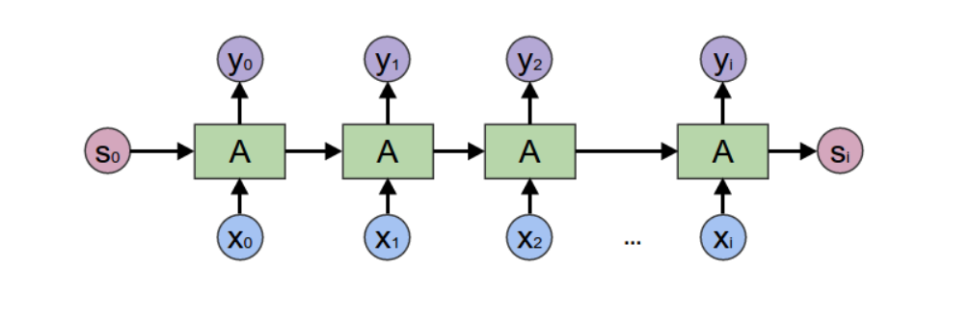

Slide 12
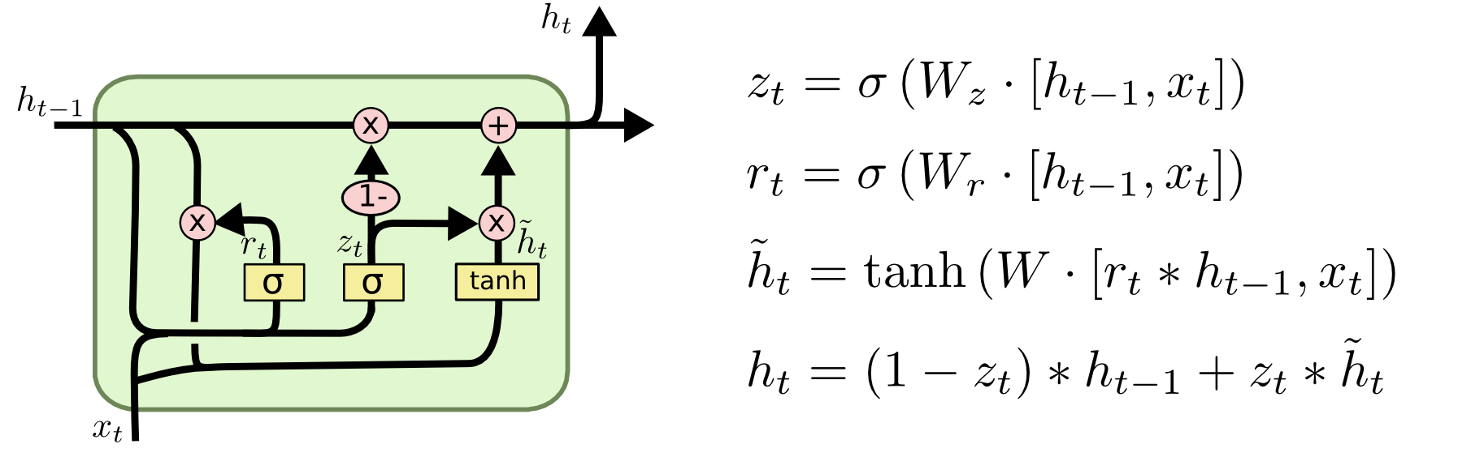
GATED RECURRENT UNITS
Controls information flow with the help of two gates - Update gate and Reset gate
These gates are the vectors which make the decision of the information to be given as output
GRU is that they can be trained to keep the information from long ago with the help of internal memory.

Slide 13
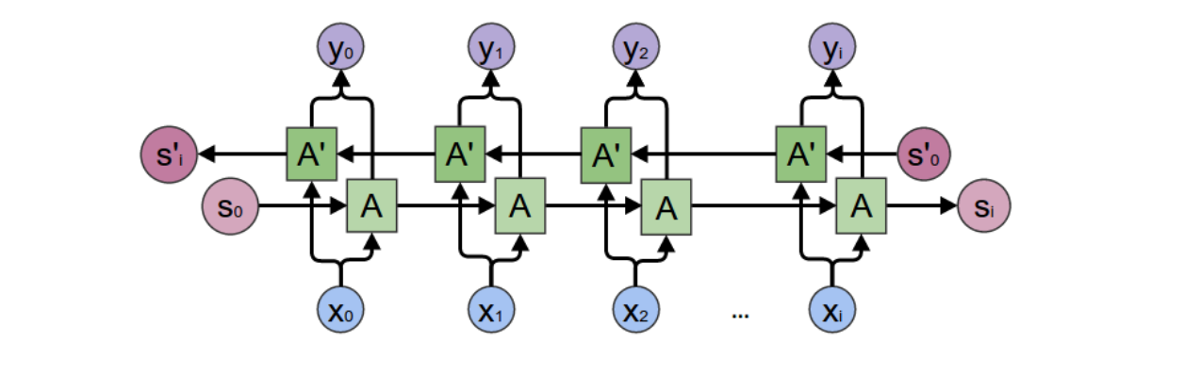
Bi-Directional RNN
Principle of Bi-RNN: Split the neurons of a regular RNN into two directions, one for positive time direction (forward states), and another for negative time direction (backward states)
Used to make predictions over a sequence with both past and future context
In a sentence, the meaning of a word depends on the words preceding and succeeding a given word.

Slide 14
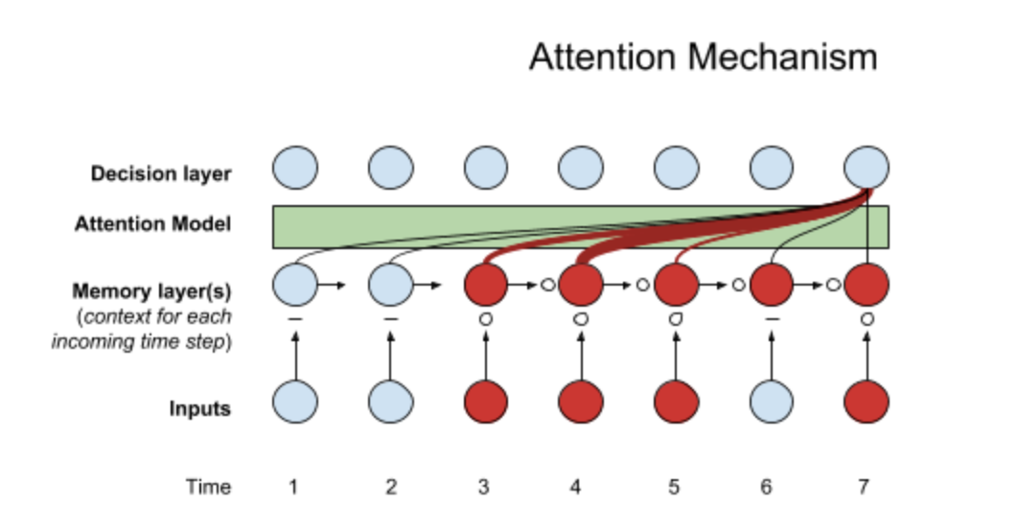
Attention Mechanism
“Attention” is defined as the “active direction of the mind to an object.”
Basic Idea: Each time the model predicts an output word, it only uses parts of an input where the most relevant information is concentrated instead of an entire sentence
It only pays attention to some input words

Slide 15
Attention Mechanism (Example)
The pound-force has a metric counterpart, less commonly used than the newton: the kilogram-force (kgf), is the force exerted by standard gravity on one kilogram of mass. the kilogram-force leads to an alternate, but rarely used unit of mass: the metric slug (sometimes mug or hyl) is that mass that accelerates at 1 m·s−2 when subjected to a force of 1 kgf. the kilogram-force is not a part of the modern SI system, and is generally deprecated; however it still sees use for some purposes as expressing aircraft weight, jet thrust, bicycle spoke tension, torque wrench settings and engine output torque. other arcane units of force include the sthène, which is equivalent to 1000 N, and the kip, which is equivalent to 1000 lbf.
What is the seldom used force unit equal to one thousand newtons?
Answer: sthène

Slide 16
Pointer Networks
Pointer networks are a variation of the sequence-to-sequence model with attention
Basic Idea: Train a fixed-size network but map it over variable-length input to get variable-length output (pointers)
Pointer Networks solve the problem of variable size output dictionaries using a mechanism of neural attention.
Uses attention as a pointer to select a member of the input sequence (passage) as the output (answer).

Slide 17
FLOWCHART OF THE WORKFLOW
The model utilizes
Word embeddings
Bidirectional Recurrent Neural Networks (Bi RNN)
Attention in neural networks to highlight
some part of the text under the context of the other.
Pointer Networks

Slide 18
RESULTS
The created model was trained on the training dataset.
Model was evaluated on training and test sets.
Model was trained on a GPU based system.
It took nearly 30 hours for training the model.
Two metrics were used to evaluate our model:
Exact Match
F1 Score

Slide 19
Metrics
Exact Match:
This metric measures the percentage of predictions that match any one of the ground truth answers exactly.
F1 Score:
This metric measures the average overlap between the prediction and ground truth answer.
We treat the prediction and ground truth answer as a bag of tokens and compute their F1.
We take the Maximum F1 over all ground truth answers for a given question.
We then average it over all the questions.

Slide 20
Results
Check Point | Training set |  |  | Test set
 | F1 Score | EM | Error | F1 Score | EM | Error
20000 | 72.2 | 57.8 | 3.1097 | 73.4508 | 64.6666 | 3.1097
30000 | 73.092 | 59.6875 | 2.5389 | 74.4508 | 65.010 | 3.094
40000 | 72.497 | 58.25 | 2.51157 | 74.1257 | 64.208 | 3.0804
50000 | 72.2673 | 58.35 | 2.5635 | 74.222 | 64.3804 | 3.124
60000 | 72.3659 | 59.3125 | 2.5355 | 74.3725 | 64.3231 | 3.088

Slide 21
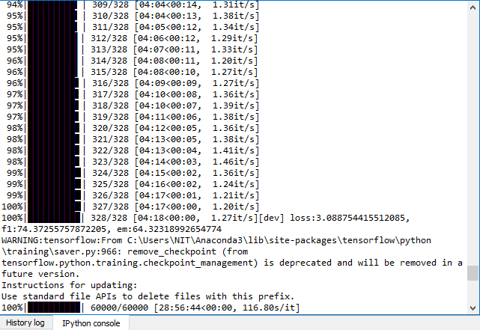

Slide 22
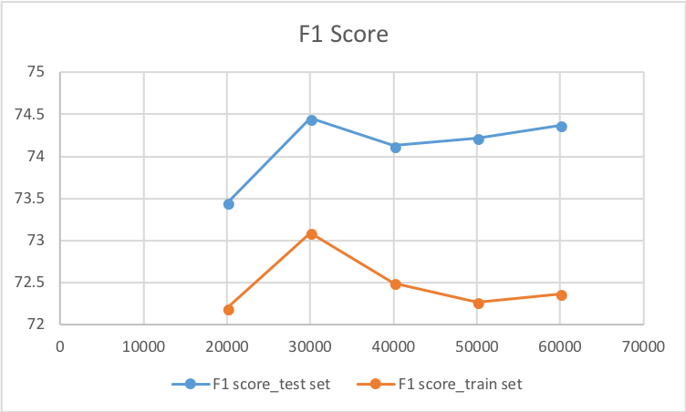
Results

Slide 23
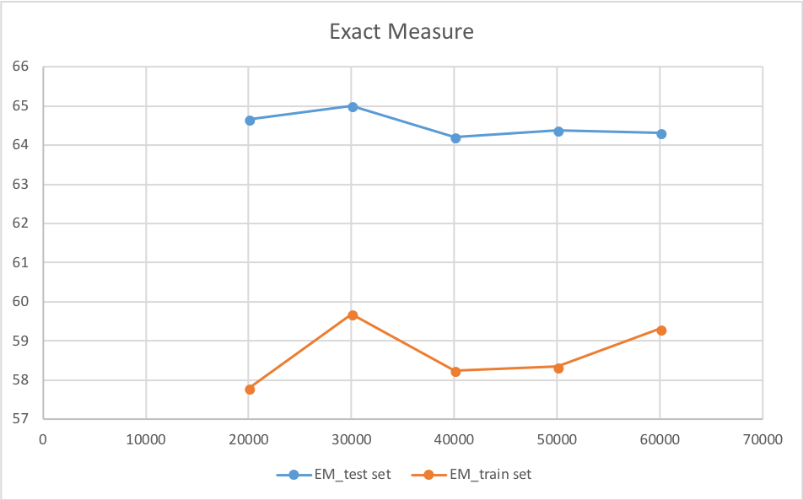
Results

Slide 24
Applications
Text Summarization
Language modelling
Speech-to-text translation
Chatbots

Slide 25
THANK YOU

